Slide 1
SUPERMART SOFTWARE
Make a customer, Not a sale
Mr. Suraj Manoj Somani
Project Guide
Prof. Gayatri Asalkar

Slide 2
֍ CERTIFICATE ֍
DEPARTEMENT OF M.C.A.
This Is to Certify That Mr. Somani Suraj Manoj of F.Y.M.C.A.
Has Satisfactorily Carried Out the Project Work According to The Syllabus Prescribed by Savitribai Phule Pune University, Pune in M.C.A. and This Project Represents His Bonafied Work in The Academic Year 2022-2023.
Roll No: - 122159

Slide 3
01
02
03
04
Problem Statement
Objective, Goals and Purpose
Project Scope of the System
Existing System

Slide 4
05
06
07
08
System Design
File Design
Form Design
Test Cases

Slide 5
Problem Statement
01.

Slide 6
PROBLEM
SOLUTION
Time taken to to manage inventory, billing and employee payroll is huge
To build a integrated system to manage inventory,billing and employee payroll.

Slide 7
02.
Objective, Goals & Purpose

Slide 8
Objective ,Goals & Purpose
Objective
Purpose
Goals
To manage the inventory effectively
To grow the business sustainably
To reduce to time spent on inventory management and billing

Slide 9
03.
Project Scope of the System

Slide 10
Project Scope of the System
Integrated System
Technically Feasible
All in one platform to perform multiple operations
System should flawlessly on the existing hardware/device
Economically Feasible
User - Friendly
System should be cost effective
No special training should be required by the user to use the system

Slide 11
04.
Existing System

Slide 12
Existing System
Employee Payroll isn’t included in the old system
Amount of data being generated is huge which has slowed down the system

Slide 13
05.
System Design

Slide 14
ENTITIES AND ATTRIBUTES
Sr No | Entity | Attributes
1 | Admin | Username, Password
2 | Employee | Id, Name, Contact, Age, Gender, Salary
3 | Stock | Product_Id, Product_Name, Quantity, Entry_Date, Price
4 | Sales | Id/Name, Quantity
5 | Report | Product_Id, Product_Name, Quantity, Entry_Date, Price

Slide 15
ENTITIES AND RELATIONSHIPS
Entity | Entity | Relationship
Admin | Employee | One - Many
Employee | Stock | One – Many
Employee | Sales | One – Many
Admin | Report | One - Many

Slide 16
E R DIAGRAM
Password
UserName
Quantity
.
Product_Id
Has
1
Admin
1
Stock
Product_Name
1
M
Id
Entry_Date
Price
Prints
M
Manage
Employee
Name
Gender
ID/Name
Age
M
M
Report
Sales
Contact
Salary
Quantity

Slide 17
CLASS DIAGRAM
ADMIN
+ username : string + password : string
+ login()
STOCK
- product_id : integer - Product_name : string - entry_date : date
+ available_stock()
.
manages
EMPLOYEE
- Id : integer - Name : string - Contact : integer - Gender : string - Age : integer
+ employee_datails()
.
.
prints
manages
REPORT
- product_id : integer - product_name : string - entry_date : string
+ report()
SALES
- id/name : integer/string - quantity : integer
+ sales_recipt()

Slide 18
USE CASE DIAGRAM
.
<<include>>
LOG IN
MANAGES EMPLOYEE PAYROLL
MANAGES STOCK
ADMIN
CONTROL OVER SALES
PRINTS SALES RECEIPT
PRINTS REPORT
.
System Boundary

Slide 19
SEQUENCE DIAGRAM
.
Admin
Admin Panel
Employee
Stock
Sales
Report
1. Login
2. Login successful
3. Employee management
4. Manages stock
7. Stock details
5. Manage sales and receipts
8. Sales details
6. History of sales report

Slide 20
ACTIVITY DIAGRAM
Initial state
.
Login
Not Successful
Enter valid credentials
Final State
Successful
Manages
Admin Panel
Manages
Manages
Stock Details
Employee Details
Sale
Details

Slide 21
COLLABORATION DIAGRAM
.
1. login details
Admin
Login
2. admin panel
2.1 choose stock details
Admin Panel
2.3 choose sales details
2.2 choose employee details
: Stock Details
:Employee Details
: Sales Details

Slide 22
OBJECT DIAGRAM
.
Admin
Login
Modifies employee info.
Employee Info
Add/ Update Database
Modifies sales info.
In database
Sales Info
Add/ Update Database
Prints report
Modifies stock info.
Report generation
Show in database
Stock Info
Add/ Update Database

Slide 23
06.
File Design

Slide 24
TABLE NAME - ADMIN
Sr No. | Field Name | Field Type | Size | Constraint | Description
1 | Username | Text | 20 | NOT NULL | Admin Name
2 | Password | Text | 20 | NOT NULL | Admin Password

Slide 25
TABLE NAME - EMPLOYEE
Sr No. | Field Name | Field Type | Size | Constraint | Description
1 | ID | Number | 5 | Primary Key | Employee ID
2 | Name | Text | 20 | NOT NULL | Employee Name
3 | Contact | Number | 10 | NOT NULL | Employee Contact
4 | Age | Number | 3 | NOT NULL | Employee Age
5 | Gender | Text | 6 | NOT NULL | Employee Gender
6 | Salary | Number | 6 | NOT NULL | Employee Salary

Slide 26
TABLE NAME - STOCK
Sr No. | Field Name | Field Type | Size | Constraint | Description
1 | Product_ID | Number | 10 | Primary Key | Product ID
2 | Product_Name | Text | 20 | NOT NULL | Product Name
3 | Quantity | Number | 5 | NOT NULL | Product Quantity
4 | Entry_Date | Date | - | NOT NULL | Product Entry Date
5 | Price | Number | 6 | NOT NULL | Product Price

Slide 27
TABLE NAME - SALES
Sr No. | Field Name | Field Type | Size | Constraint | Description
1 | Id/Name | Number/Text | 20 | NOT NULL | Sales ID/Name
2 | Quantity | Number | 5 | NOT NULL | Sales Quantity

Slide 28
TABLE NAME - REPORT
Sr No. | Field Name | Field Type | Size | Constraint | Description
1 | Product_ID | Number | 10 | Primary Key | Product ID
2 | Product_Name | Text | 20 | NOT NULL | Product Name
3 | Quantity | Number | 5 | NOT NULL | Product Quantity
4 | Entry_Date | Date | - | NOT NULL | Product Entry Date
5 | Price | Number | 6 | NOT NULL | Product Price

Slide 29
08.
Form Design

Slide 30
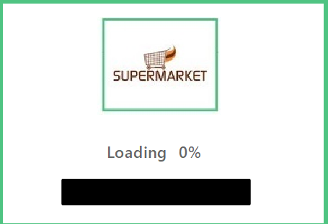
SPLASH SCREEN

Slide 31
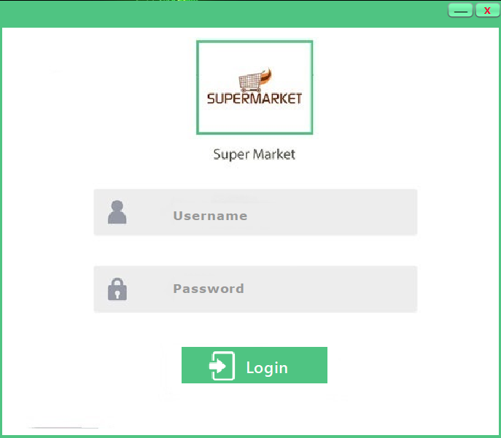
LOGIN PAGE

Slide 32
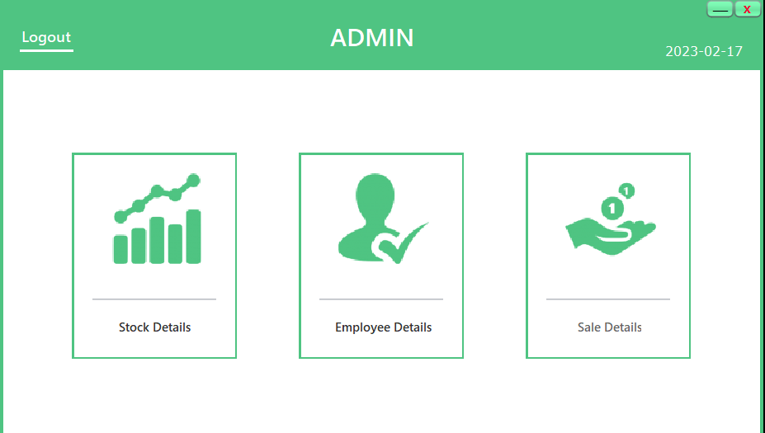
ADMIN PAGE

Slide 33
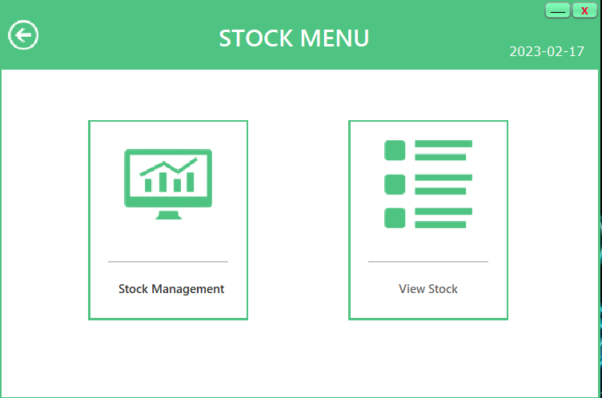
STOCK MENU

Slide 34
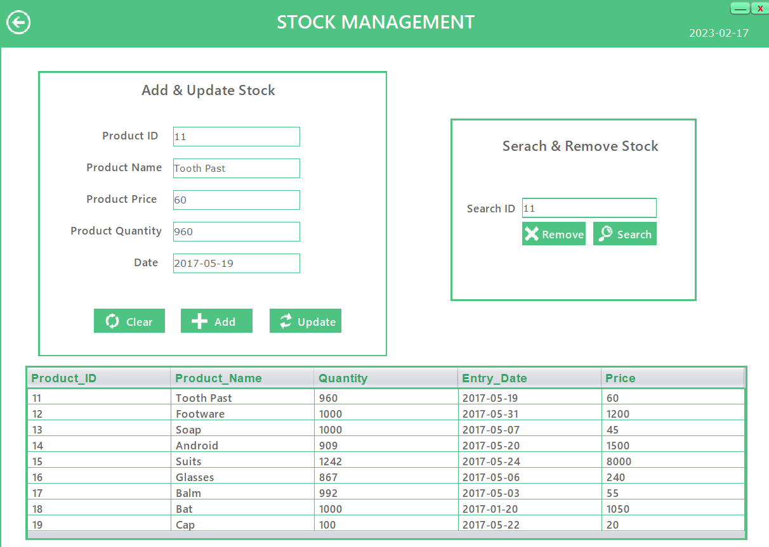
STOCK MANAGEMENT

Slide 35
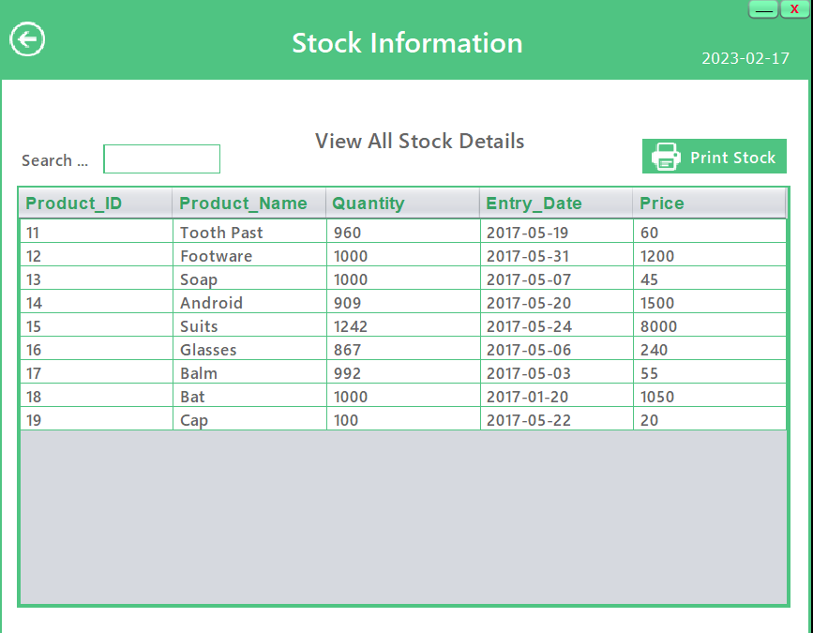
STOCK INFORMATION

Slide 36
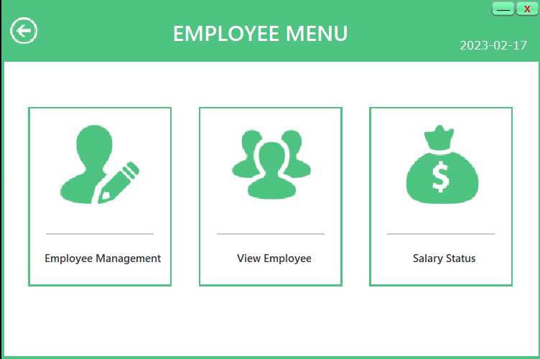
EMPLOYEE MENU

Slide 37
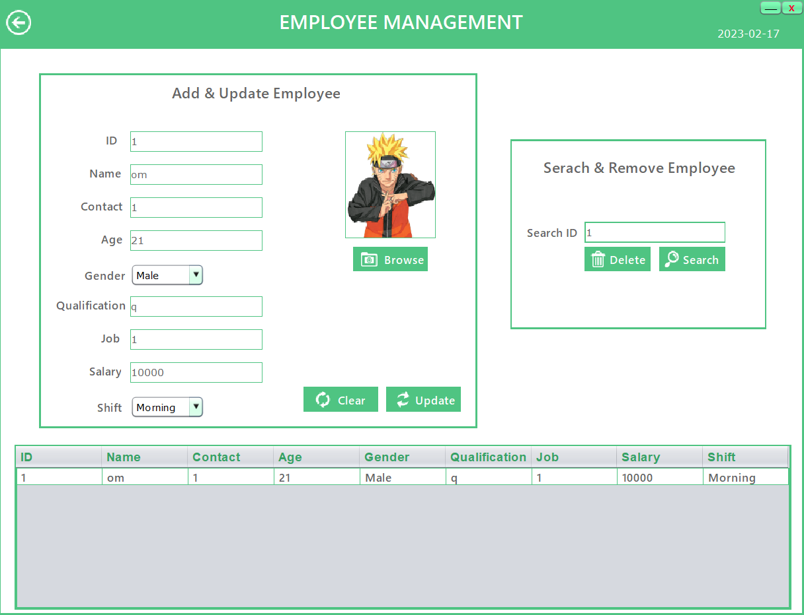
EMPLOYEE MANAGEMENT

Slide 38
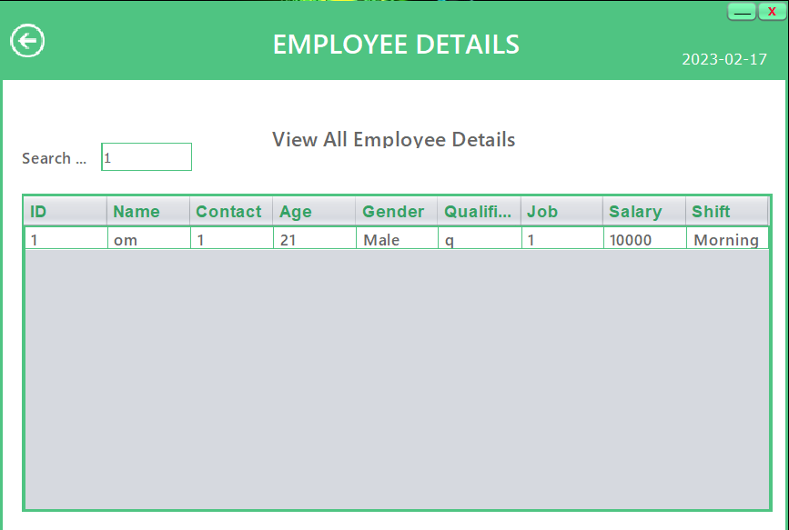
EMPLOYEE DETAILS

Slide 39
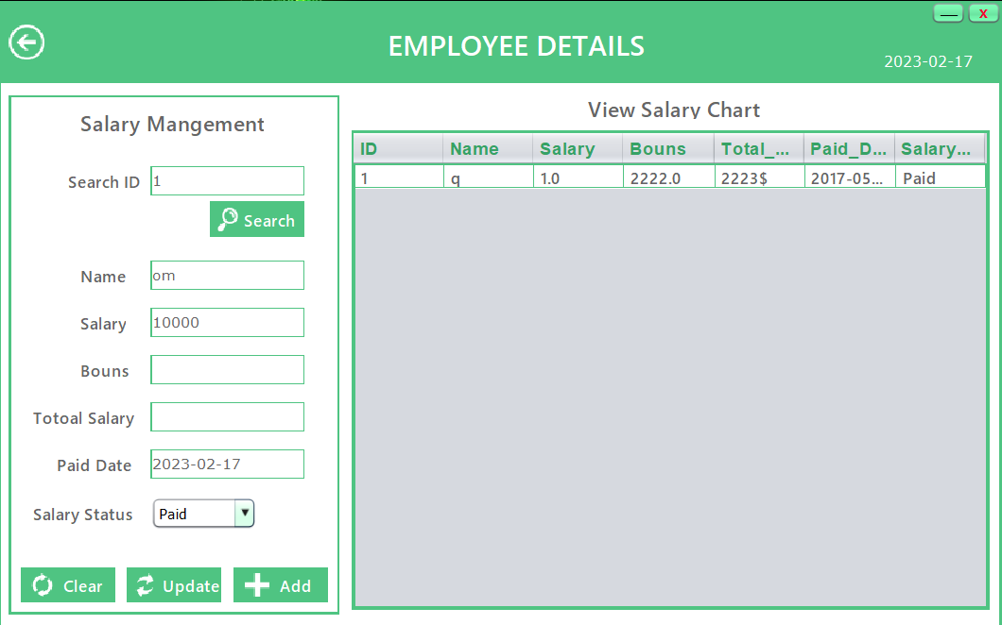
SALARY MANAGEMENT

Slide 40
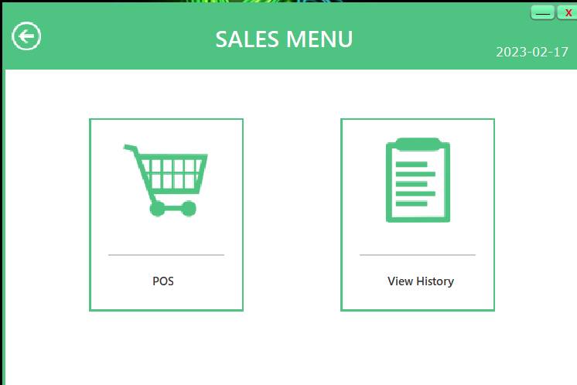
SALES MENU

Slide 41
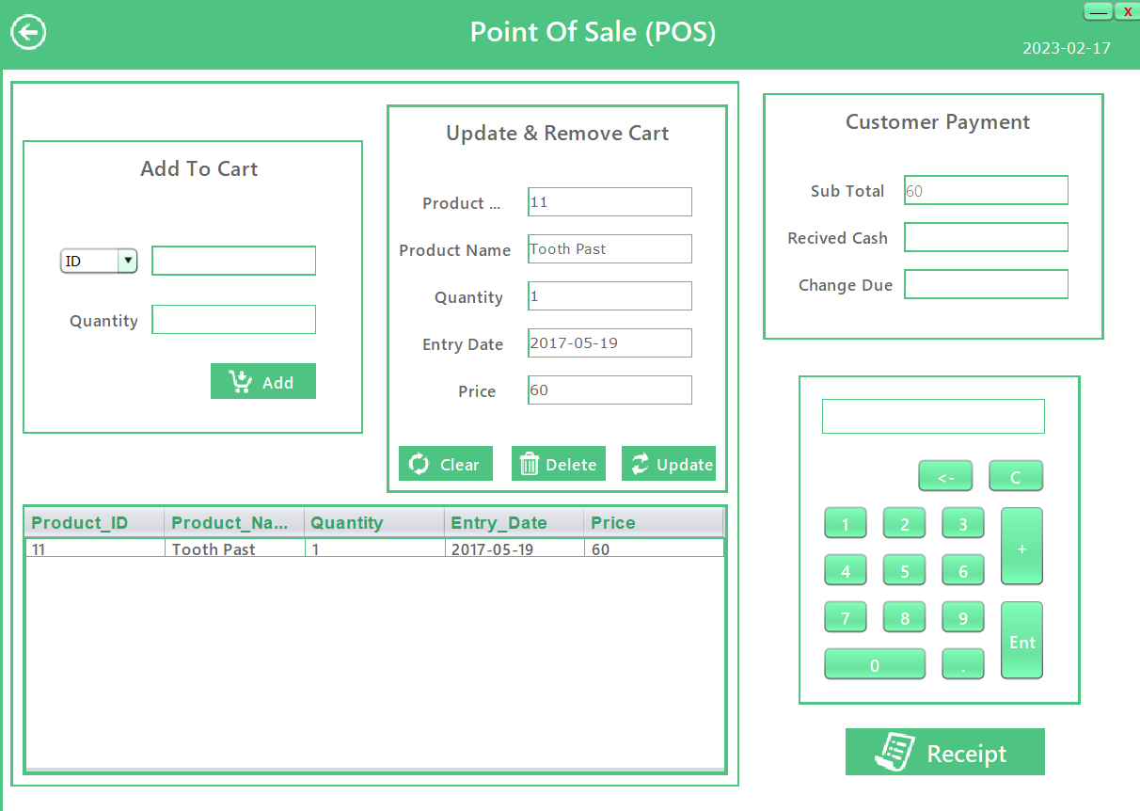
POINT OF SALES (POS)

Slide 42
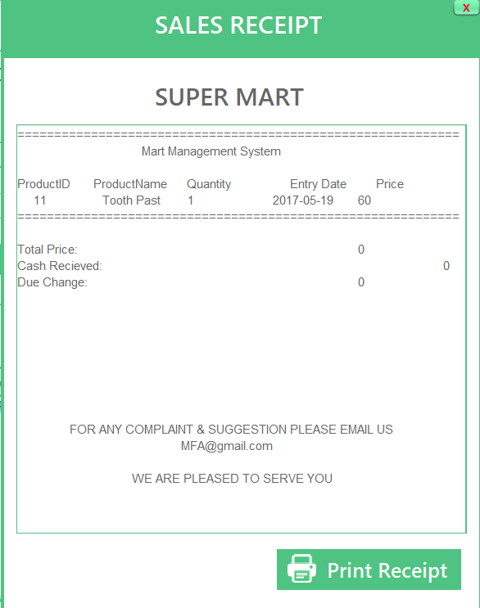
SALES RECIPT

Slide 43
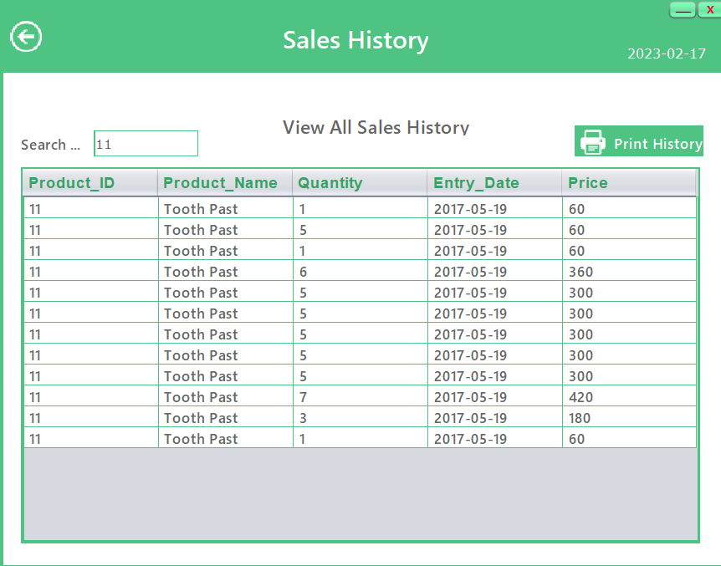
SALES HISTORY

Slide 44
08.
Test Cases

Slide 45
TEST CASES
Test Case # | Test Case Description | Test Data | Expected Result
1 | Verify that the user is able to log in with valid credentials and is denied access with invalid credentials. | Username : admin Password: admin | Login should be successful.
2 | Search for a product by name and id verify that the correct product details are displayed. | Id : 11 | Product details should be correctly displayed.
3 | Add one or more products to the cart and verify that the total amount is updated accordingly. | Id:11, Quantity: 5 Id:12, Quantity: 4 | The product details should be properly added and updated accordingly.
4 | Remove one or more products from the cart and verify that the total amount is updated. | Id:11 | The product details should be properly remove and updated accordingly.
5 | Verify that the software allows the user to add, edit, and delete employee information, including personal details, job title, salary, and performance evaluations. | Id: 1, name: om, contact:9865784565, age: 21, qualification: -, salary:10000 | The employee details should be properly add, edit and remove accordingly.
6 | Verify that the software is able to calculate employee salaries and show the salaries are paid or not. | Id:1, name: om, salary: 10000, Bonus: 1200, paid_date: 17-02-23, salary status: paid | The employee salary should be paid or not and updates accordingly.

Slide 46
TEST CASES
Test Case # | Test Case Description | Test Data | Expected Result
7 | Add and update one or more products from stock and updated their amount and quantity accordingly. | Id: 11, name: Tooth Paste, price: 120, quantity: 15 | The stock details should be properly added and updated accordingly.
8 | Search the product from stock and show the details. | Id:11 | The stock details should be display
9 | Remove one or more products from the stock and verify that the product details updated. | Id:11 | The product details from stock should be properly remove accordingly.
10 | Verify that the software is able to generate sales receipt , shows the proper amount and details of the product | Id: 11, name: Tooth Paste, price: 120, quantity: 1 | The product details and the sales details with the proper amount should be display properly.
11 | Verify that the software is able to generate reports, such as sales reports. | Product_id : 11 | The product details and the sales details should be display properly.

Slide 47
09.
Data Dictionary

Slide 48
DATA DICTIONARY
No | Data Element | Description | Datatype | Size | List of specific | Data store | Remarks
1 | Username | Admin Name | Text | 20 | It store admin name | Admin Muster | It contain admin name
2 | Password | Admin Password | Text | 20 | It store admin password | Admin Muster | It contain admin password
3 | Id | Employee ID | Number | 5 | It stores employee number | Employee Muster | It contain employee number
4 | Name | Employee Name | Text | 20 | It stores employee name | Employee Muster | It contain employee name
5 | Contact | Employee Contact Number | Number | 10 | It stores employee contact number | Employee Muster | It contain employee contact
6 | Age | Employee Age | Number | 3 | It stores employee age | Employee Muster | It contain employee age
7 | Gender | Employee Gender | Text | 6 | It stores employee gender | Employee Muster | It contain employee gender
8 | Salary | Employee Salary | Number | 6 | It stores employee salary | Employee Muster | It contain employee salary

Slide 49
DATA DICTIONARY
No | Data Element | Description | Datatype | Size | List of specific | Data store | Remarks
9 | Product_Id | Product Id | Number | 10 | It store product ID | Product Muster | It contain product Id
10 | Product_Name | Product Name | Text | 20 | It store product name | Product Muster | It contain product name
11 | Quantity | Product Quantity | Number | 5 | It stores product quantity | Product Muster | It contain product quantity
12 | Entry_Date | Product Entry Date | Date | - | It stores product entry date | Product Muster | It contain product entry date
13 | Price | Product Price | Number | 6 | It stores product price | Product Muster | It contain product price
14 | Id/Name | Sales ID/Name | Number/Text | 20 | It stores sales ID/ name | Sales Muster | It contain sales Id/Name
15 | Quantity | Sales Quantity | Number | 5 | It stores sales quantity | Sales Muster | It contain sales quantity

Slide 50
THANKS!
Do you have any questions?
By Suraj Manoj Somani

